Slide 1


Vivekananda College of Engineering & Technology
[A Unit of Vivekananda Vidyavardhaka Sangha, Puttur®] Affiliated to Visvesvaraya Technological University, Belagavi
Approved by AICTE New Delhi & Recognised by Govt of Karnataka
Major Project Presentation on
“EEG-HDC” – EEG Based Hierarchical Detection & Classification of Seizures.
Guided by
Prof. Pradeep Kumar K G
HoD, CSE
Presented by
Aashitha Prabhu B (4VP23CS001) Abhayraj Bhat N (4VP23CS002) Adithya (4VP23CS004)
Ashwini (4VP23CS017)
DEPARTMENT OF COMPUTER SCIENCE & ENGINEERING 2025-26

Slide 2
Contents
Introduction 3
Problem Statement 4
Objectives 5
Literature Survey 6–14
Architecture Diagram 15
Expected Outcomes 16
System Architecture 17
Datasets & Preprocessing 18–19
Model Design (CRNN, Training, Dual-Embedding, SMOTE) 20–23
Models Compared & Implementation 24–25
Results & Comparisons 26–36
Limitations & Future Enhancements 37
Conclusion 38
References 39–48

Slide 3
Introduction
A seizure is a sudden abnormal electrical activity in the brain, analyzed using EEG signals that record multi-channel brain activity. This project proposes a hierarchical deep learning framework that first detects seizure segments and then classifies them into Focal, Focal to Bilateral Tonic-Clonic, and Generalized Tonic-Clonic types using transfer learning to improve classification.

Slide 4
Problem Statement
To detect and accurately classify seizure events into their respective subtypes from EEG signals for clinical applications using advanced deep learning methodologies.

Slide 5
Objectives
To acquire and preprocess EEG datasets through signal cleaning, filtering, normalization, and segmentation.
To develop a hierarchical deep learning framework for seizure detection and subsequent seizure subtype classification using transfer learning.
To implement hybrid model and evaluate an automated multi-class seizure subtype classification system using subject-wise validation metrics.

Slide 6
Sl. No | Reference Paper | Advantages | Limitations
1 | N. Ilakiyaselvan, A. Nayeemulla Khan, and A. Shahina - Deep learning approach to detect seizure using reconstructed phase space images | Effectively captures nonlinear EEG dynamics and achieves high accuracy (~98.5%). The use of RPS with CNN improves representation of complex patterns. | Requires conversion of signals into images, increasing preprocessing steps. This adds computational overhead and complexity to the pipeline.
2 | S. Srinivasan, Sundaranarayana Dayalane, Sandeep Kumar Mathivanan, Hariharan Rajadurai, Prabhu Jayagopal, and Gemmachis Teshite Dalu - Detection and classification of adult epilepsy using hybrid deep learning approach | 3D-DCAE + Bi-LSTM achieved very high performance (≈99.08% accuracy, 99.16% F1) on CHB-MIT paediatric EEG. The end-to-end supervised autoencoder is trained once, reducing parameters via convolutional layers and compressing EEG into a low-dimensional latent space for a compact, high-precision classifier. | Evaluated only on the CHB-MIT dataset (23 paediatric patients), so its performance on adult or larger cohorts is untested. It performs only binary (ictal vs. interictal) classification, ignoring multiple seizure types and pre-ictal states, which may limit clinical applicability.
3 | Hezam Albaqami, G. M. Hassan, and A. Datta - Wavelet-Based Multi-Class Seizure Type Classification System | Using TUH EEG Seizure Corpus (TUSZ v1.5.2) (3050 seizures, 300+ patients), the method classifies seven seizure types with ~96.0% accuracy and 99.1% weighted F1 (seizure-wise). DTCWT features with LightGBM set a new benchmark, outperforming prior methods. | Patient-wise evaluation drops to 74.7% F1, indicating poor cross-subject generalization. The method uses fixed wavelet features with LightGBM, lacks end-to-end learning, and is not validated on independent or noisy datasets.

Slide 7
4 | A. Abdelhameed and M. Bayoumi - A Deep Learning Approach for Automatic Seizure Detection in Children With Epilepsy | Achieves high accuracy (~98.8%) with automatic feature learning. Requires minimal preprocessing using deep learning models. | Performance is dataset-specific and may not generalize well. High computational cost limits practical deployment.
5 | M. Guendelman, R. Vekslar, and O. Shriki - A New Perspective in Epileptic Seizure Classification: Applying the Taxonomy of Seizure Dynamo types to Non-invasive EEG and Examining Dynamical Changes across Sleep Stages | Provides interpretable seizure dynamics and links them with sleep stages. Offers a scalable and explainable modeling approach | Depends on manual labeling which increases effort. Performance is sensitive to noise in EEG signals.
6 | M. K. Siddiqui, R. Morales-Menendez, X. Huang, and N. Hussain - A review of epileptic seizure detection using machine learning classifiers | Gives a comprehensive comparison of classifiers and identifies strong models. Helps understand effectiveness of traditional ML techniques. | Lacks experimental validation to support conclusions. Limited focus on deep learning approaches.
7 | Y. Yuan et al. - A Transformer‐Based Framework With Data Augmentation for Robust Seizure Detection Across Invasive and Non-invasive Neural Recordings | Provides high generalization and eliminates need for manual feature extraction. Uses attention mechanisms effectively with augmented data. | Sensitive to noise in EEG signals. High computational cost makes it resource intensive.
8 | P. A. Akor, G. Enemali, U. Muhammad, R. R. Singh, and H. Larijani - An Attention-Residual Convolutional Network for Real-Time Seizure Classification on Edge Devices | Achieves very high accuracy and supports real-time edge deployment. Combines attention and residual learning for efficient performance. | Relies on handcrafted features which limits automation. Feature dependency may affect scalability.

Slide 8
10 | A. Ulate-Campos, F. Coughlin, M. Gaínza-Lein, I. S. Fernández, P. L. Pearl, and T. Loddenkemper - Automated seizure detection systems and their effectiveness for each type of seizure | Offers practical insights using multi-sensor systems like EEG and ECG. Helps in selecting suitable devices for detection. | Does not provide a unified detection framework. Integration across systems remains unclear.
11 | U. R. Acharya, Y. Hagiwara, and H. Adeli - Automated seizure prediction | Covers advanced prediction techniques using ML models. Explores feature engineering for improved forecasting. | Reliability is lower compared to detection systems. Prediction accuracy is still a major challenge.
12 | X. Wei, L. Zhou, Z. Chen, L. Zhang, and Y. Zhou - Automatic seizure detection using three-dimensional CNN based on multi-channel EEG | Captures spatial and temporal EEG features effectively. Improves detection using multi-channel modeling. | Requires complex data representation and processing. Increases computational burden significantly.
13 | R. San-Segundo, M. Gil-Martín, L. F. D’Haro-Enríquez, and J. M. Pardo - Classification of epileptic EEG recordings using signal transforms and convolutional neural networks | Achieves very high accuracy (~99.5%) using hybrid techniques. Combines signal transforms with deep learning effectively. | Strong dependence on preprocessing techniques. Performance varies based on transform quality.
14 | Y. Wang, Y. Shi, Z. He, Z. Chen, and Y. Zhou - Combining temporal and spatial attention for seizure prediction | Captures both spatial and temporal dependencies in EEG data. Achieves high accuracy (98.25%) with very low false positives. | Model complexity is high due to combined architectures. Requires structured multi-channel EEG data.

Slide 9
15 | L. Bai, G. Litscher, and X. Li - Epileptic Seizure Detection Using Machine Learning: A Systematic Review and Meta-Analysis | Improves performance through model fusion techniques. Achieves good accuracy (~96.17%). | Ensemble increases model complexity. Generalization analysis is limited.
16 | I. Jemal, L. Abou-Abbas, Khadidja Henni, Amar Mitiche, and Neila Mezghani - Domain adaptation for EEG-based, cross-subject epileptic seizure prediction | Improves generalization across different patients. Achieves ~10% accuracy improvement. | Still affected by domain shift issues. Requires large multi-patient datasets.
17 | B. Priya Prathaban and R. Balasubramanian - Dynamic learning framework for epileptic seizure prediction using sparsity based EEG Reconstruction with Optimized CNN classifier | Provides high performance (~98% accuracy) and early prediction (~1.1 hr prior). Reduces false positives significantly. | Pipeline is complex with multiple stages. Computational cost is high due to processing steps.
18 | S. Raghu, N. Sriraam, Y. Temel, S. V. Rao, and P. L. Kubben - EEG based multi-class seizure type classification using convolutional neural network and transfer learning | Enables effective multi-class classification using pretrained models like AlexNet and InceptionV3. Improves learning efficiency through transfer learning techniques. | Achieves only moderate accuracy (~88%) compared to advanced models. Requires spectrogram conversion which adds preprocessing complexity.
19 | S. Wong et al. - EEG datasets for seizure detection and prediction— A review | Improves dataset selection and enhances reproducibility in research. Provides useful insights into ML pipeline design. | Does not include experimental validation of methods. Relies entirely on existing studies and datasets.
20 | A. A. Ein Shoka, M. M. Dessouky, A. El-Sayed, and E. E.-D. Hemdan - EEG seizure detection: concepts, techniques, challenges, and future trends | Offers a comprehensive overview of detection pipelines and techniques. Identifies key challenges and future research directions. | Lacks quantitative benchmarking for comparison. Does not provide experimental performance results.

Slide 10
21 | W. Cao, Q. Li, A. Zhang, and T. Wang - Efficient and Accurate Epilepsy Seizure Prediction and Detection Based on Multi-Teacher Knowledge Distillation RGF-Model | Achieves very high accuracy (99%+) with lightweight and real-time capability. Efficiently transfers knowledge across models. | Architecture is complex and difficult to design. Implementation may require careful tuning and optimization.
22 | N. McCallan et al. - Epileptic multi-seizure type classification using electroencephalogram signals from the Temple University Hospital Seizure Corpus: A review | Highlights best-performing deep learning models for seizure classification. Provides comparative insights across multiple approaches. | Lacks standardization across studies and datasets. Results may not be directly comparable.
23 | M. Zhou et al. - Epileptic Seizure Detection Based on EEG Signals and CNN | Achieves high accuracy (~97%) without manual feature extraction. Learns features directly from raw EEG signals. | Performance depends heavily on signal representation. Different domains may affect accuracy.
24 | A. T. Tzallas, M. G. Tsipouras, and D. I. Fotiadis - Epileptic Seizure Detection in EEGs Using Time–Frequency Analysis | Effectively handles non-stationary EEG signals using time-frequency methods. Improves feature representation quality. | Feature extraction pipeline is complex and time-consuming. Requires multiple transformation steps.
25 | A. Subasi, J. Kevric, and M. Abdullah Canbaz - Epileptic seizure detection using hybrid machine learning methods | Achieves very high accuracy (~99.38%) with optimized parameters. Combines DWT and SVM effectively. | Requires handcrafted features which limit automation. Model performance depends on feature quality.
26 | M. S. Farooq, A. Zulfiqar, and S. Riaz - Epileptic Seizure Detection Using Machine Learning: Taxonomy, Opportunities, and Challenges | Provides a comprehensive taxonomy and identifies research gaps. Helps guide future work in seizure detection. | Does not include experimental validation. Focus remains theoretical and descriptive.

Slide 11
27 | E. Ali, M. Angelova, and Chandan Karmakar - Epileptic seizure detection using CHB-MIT dataset: The overlooked perspectives | Performs real-world evaluation handling imbalance and variability. Provides practical insights using Random Forest. | Shows moderate sensitivity (~75%) in detection. Pipeline is relatively complex.
28 | A. Shoeibi et al. - Epileptic Seizures Detection Using Deep Learning Techniques: A Review | Provides a comprehensive overview of deep learning models. Identifies best-performing architectures for seizure detection. | No experimental validation is included. Analysis remains high-level and descriptive.
29 | T. K. Murugan and A. Kameswaran - Employing convolutional neural networks and explainable artificial intelligence for the detection of seizures from electroencephalogram signal | Improves interpretability and clinical trust using XAI techniques. Maintains good accuracy in detection. | Adds extra complexity due to explainability methods. Performance depends on feature quality.
30 | S. Cuyckens, R. Antonio, C. Fang, and M. Verhelst - iEEG Seizure Detection with a Sparse Hyperdimensional Computing Accelerator | Offers very low energy consumption and supports real-time detection. Suitable for hardware-efficient implementations. | Implementation is complex and hardware-dependent. Validation scope is limited.
31 | P. Thodoroff, J. Pineau, and A. Lim - Learning Robust Features using Deep Learning for Automatic Seizure Detection | Learns robust cross-patient features without manual extraction. Improves generalization across datasets. | Computationally intensive and resource-demanding. Performance depends on data quality.
32 | Th. Sverrisson and S. Gudmundsson - LookAroundNet: Extending Temporal Context with Transformers for Clinically Viable EEG Seizure Detection | Captures long-range dependencies and improves generalization. Provides strong performance using temporal context modeling. | High computational cost due to transformer models. Requires large-scale datasets.

Slide 12
33 | Giorgos Giannakakis, Vangelis Sakkalis, M. Pediaditis, and Manolis Tsiknakis - Methods for Seizure Detection and Prediction: An Overview | Provides a comprehensive comparison of detection methods. Achieves high accuracy using engineered features. | Relies on handcrafted features rather than deep learning. Limited modern DL-based insights.
34 | Y. Yang, K. Guo, Z. Fang, H. Lin, M. Grosser, and J. Lu - Multi-model Transfer Learning and Genotypic Analysis for Seizure Type Classification | Improves accuracy by 13–16% and handles data scarcity. Combines multiple models for better performance. | Architecture is complex and difficult to manage. Requires multi-source data integration.
35 | D. Ahmedt-Aristizabal, T. Fernando, S. Denman, L. Petersson, M. J. Aburn, and C. Fookes - Neural Memory Networks for Seizure Type Classification | Captures long-term dependencies and achieves high F1-score (~0.945). Enhances sequence modeling capability. | High model complexity increases computation. Limited dataset availability affects training.
36 | S. Ghosh, V. Singh, and O. S. Powar - Seizure detection using EEG on the CHB-MIT dataset via multi-domain feature engineering and classical machine learning | Provides interpretable results with low latency. Supports patient-independent evaluation. | Lower accuracy compared to deep learning models. Performance may be limited.
37 | M. L. Scheuer, S. B. Wilson, A. Antony, G. Ghearing, A. Urban, and A. I. Bagić - Seizure Detection: Interreader Agreement and Detection Algorithm Assessments Using a Large Dataset | Demonstrates expert-level algorithm performance. Compares human and algorithm outputs effectively. | Highlights variability and lack of perfect ground truth. Evaluation uncertainty remains.

Slide 13
38 | S. Roy, U. Asif, J. Tang, and S. Harrer - Seizure Type Classification Using EEG Signals and Machine Learning: Setting a Benchmark | Provides benchmark study for multi-class classification. Uses multiple ML models for comparison. | Poor generalization in patient-wise validation. Performance varies across datasets.
39 | C. Baumgartner and J. P. Koren - Seizure detection using scalp-EEG | Provides clinical insights and performance ranges. Useful for understanding real-world applications. | Not a specific model and lacks implementation details. Limited practical usability.
40 | U. Asif, S. Roy, J. Tang, and S. Harrer - SeizureNet: Multi-Spectral Deep Feature Learning for Seizure Type Classification | Achieves high F1-score (~0.94) with strong feature representation. Uses multi-spectral features effectively. | Shows moderate generalization performance. Patient-wise F1-score is relatively low (~0.59).
41 | SeizureTransformer: Scaling U-Net with Transformer for Simultaneous Time-Step Level Seizure Detection from Long EEG Recordings | Captures long-range dependencies and achieves state-of-the-art performance. Combines CNN and transformer effectively. | High computational cost and complex architecture. Requires significant resources.
42 | W. Weng et al. - Self-supervised Learning for Electroencephalogram: A Systematic Survey | Reduces dependency on labeled data and improves generalization. Explores multiple SSL strategies. | Requires careful design of pretext tasks. Training process is complex.
43 | J. J. Falco-Walter, I. E. Scheffer, and R. S. Fisher - The new definition and classification of seizures and epilepsy | Provides standardized labels improving dataset consistency. Supports better machine learning applications. | Not a predictive model or algorithm. Lacks computational framework.

Slide 14
44 | L. Wei and C. Mooney - Transfer Learning-based Seizure Detection on Multiple Channels of Paediatric EEGs | Achieves good accuracy (~85%) with reduced training cost. Supports multi-channel data fusion. | Depends on spectrogram transformation. Scalability is moderate.
45 | H. Banville, O. Chehab, A. Hyvärinen, D.-A. Engemann, and A. Gramfort - Uncovering the structure of clinical EEG signals with self-supervised learning | Works effectively with unlabeled data and learns robust features. Provides strong generalization. | Training is complex and requires careful task design. Computational effort is high
46 | A. Shoeibi et al. - Automatic Diagnosis of Schizophrenia in EEG Signals Using CNN-LSTM Models | Achieves very high accuracy (~99.25%) with strong spatial-temporal learning. Reduces need for manual feature extraction. | Dataset is small (28 subjects) limiting generalization. Focuses only on binary classification.

Slide 15
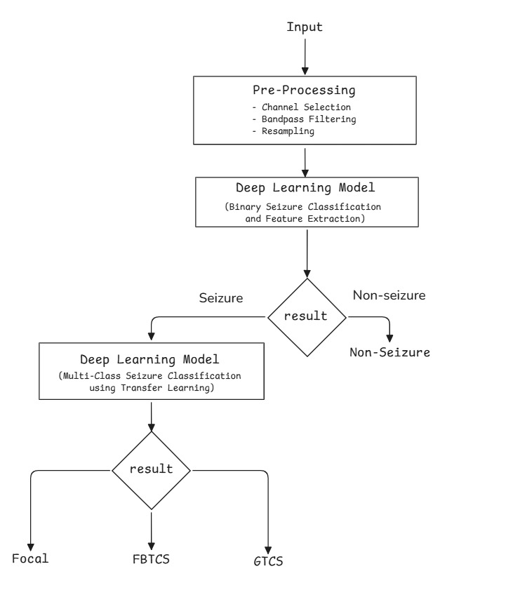
Architecture diagram

Slide 16
Expected Outcomes
A standardized and pre-processed EEG dataset with cleaned, filtered, normalized, and segmented seizure recordings suitable for deep learning analysis.
A functional hierarchical deep learning framework capable of performing seizure detection followed by seizure subtype classification using transfer learning.
An evaluated automated multi-class seizure classification system with validated performance metrics (e.g., accuracy, precision, recall, F1-score) using subject wise cross validation.

Slide 17
System Architecture
Data & Preprocessing
Stage 1: Detection
Stage 2: Subtype
CHB-MIT + Siena
scalp EEG
4 s windows
18 × 1024 samples
Frozen + fine-tuned CRNN
128-D + 128-D = 256-D
18-channel bipolar
(double-banana) montage
CRNN backbone
Conv → BiLSTM → Attention
Latent-space SMOTE
(training split only)
Notch + 0.5–45 Hz bandpass
Resample to 256 Hz
Focal loss training
Threshold = 0.65
HistGradientBoosting
classifier
Windowing +
artifact rejection
Seizure / Non-seizure
Focal Aware · Focal Impaired
Awareness · FBTC
Only windows flagged as seizure by Stage 1 are passed to the subtype stage.
Notes:
Our system works in two stages, like a doctor's workflow. First comes data preparation: we take raw EEG from two public datasets (CHB-MIT and Siena), put them in the same 18-channel layout, clean them and cut them into short windows.
Stage 1 asks one simple question: is this window a seizure or not? We use a CRNN (a neural network with three parts: conv layers, an LSTM and attention) to get a seizure probability, and a threshold of 0.65 to turn it into yes/no.
Only the windows flagged as seizure go to Stage 2. Stage 2 asks: which type? We use two copies of the network, one frozen and one fine-tuned, join their outputs into 256 numbers, balance the rare classes with SMOTE and let a HistGB classifier choose between Focal Aware, Focal Impaired Awareness and FBTC.
Key message: detect first, then classify.

Slide 18
Datasets
 | CHB-MIT Scalp EEG | Siena Scalp EEG
Subjects | 24 (paediatric) | 14 (adult); 13 with usable subtype labels
Native format | 18-ch bipolar, 256 Hz | Monopolar 10–20 referential, 512 Hz
Labels | Seizure / non-seizure | ILAE seizure type per patient
Used for | Stage 1 detection | Stage 1 detection + Stage 2 subtype
Stage 1: 928,154 four-second windows from both datasets (subject-level train / val / test split).
Stage 2: 1,824 ten-second seizure windows from Siena only.
Class imbalance: Focal Impaired Awareness (11 patients) vs Focal Aware (1) and FBTC (1).
Test set (subtype): 550 windows – 16 FA, 497 FIA, 37 FBTC.
Notes:
We use two public EEG datasets from PhysioNet. CHB-MIT has 24 children and only says seizure or not. Siena has 14 adults (13 usable) and, importantly, gives the seizure type, so subtype learning can only use Siena.
Stage 1 uses both datasets: 928,154 windows of 4 seconds. Stage 2 uses Siena seizure windows only: 1,824 windows of 10 seconds.
Point out the imbalance: 11 of 13 patients have Focal Impaired Awareness; Focal Aware and FBTC each come from just one patient. That is why this problem is hard.
The test set for subtype has 550 windows: 16 FA, 497 FIA and 37 FBTC.

Slide 19
Preprocessing Pipeline
Montage harmonization: Both datasets mapped to an 18-channel longitudinal bipolar (double-banana) montage in a fixed anatomical order.
Filtering: Notch filter (60 Hz CHB-MIT / 50 Hz Siena), then 0.5–45 Hz zero-phase FIR bandpass, so that seizure-onset timing is not shifted.
Resampling: Siena (512 Hz) downsampled to 256 Hz, applied last.
Stage 1 windows: 4 s; background stride 4 s, seizure stride 1 s; label = seizure if ≥ 50 % overlap; ±5 min around seizures excluded from the normal class.
Stage 2 windows: 10 s with 2 s stride, Siena seizure events only.
Artifact rejection: Peak-to-peak threshold calibrated on the data (a fixed 500 µV cutoff would have discarded real seizures).
Normalization: Per-channel z-score at training time.
Notes:
Raw EEG from different hospitals is messy and different, so we standardise it.
Montage: both datasets are converted to the same 18-channel layout (the double-banana, each channel is the voltage difference between two neighbouring electrodes) in a fixed order.
Filtering: remove power-line hum (60 Hz for CHB-MIT, 50 Hz for Siena), then keep only 0.5 to 45 Hz, where brain activity lives. We use a zero-phase filter so the timing of the seizure is not shifted.
Resampling: Siena is 512 Hz, we bring it to 256 Hz.
Windowing: Stage 1 uses 4-second windows; seizure windows overlap more (1 s stride) to get extra seizure examples. Stage 2 uses 10-second windows.
Artifact rejection: we remove windows with absurdly large amplitudes (movement, loose electrodes). We calibrated this threshold on the data because a fixed 500 microvolt cutoff would have deleted real seizures.

Slide 20
CRNN Backbone
Layer | Configuration | Output
Conv Block 1 | Conv1d 18→32, k = 63, s = 2 | 32
Conv Block 2 | Conv1d 32→64, k = 31, s = 2 | 64
Conv Block 3 | Conv1d 64→128, k = 15, s = 2 | 128
Conv Block 4 | Conv1d 128→128, k = 7, s = 2 | 128
Bi-LSTM | 1 layer, 64 hidden units per direction | 128
Attention Pool | Linear → Tanh → Linear → softmax over time | 128-D vector
Each conv block: BatchNorm → ReLU → Dropout (0.1).
Time axis downsampled 16×.
445,697 parameters per backbone.
Attention pooling makes the backbone length-agnostic (1024-sample detection and 2560-sample subtype windows).
Detection head: focal loss (γ = 2), balanced sampling, Adam with ReduceLROnPlateau, 25 epochs.
Notes:
This is the core network, used for both detection and subtype. Read the table top to bottom.
Four conv blocks slide filters along the signal to detect shapes. The first filter is wide (63 samples) to catch slow waves; later ones are narrow to catch sharp spikes. Each block halves the length, so the signal ends up 16 times shorter but richer (32, 64, 128, 128 feature channels).
The Bi-LSTM reads the shortened sequence forwards and backwards so it understands the order of events.
Attention pooling gives every time step an importance score and takes a weighted average, producing one 128-number summary called the embedding.
445,697 adjustable numbers (weights) in total. Because of attention pooling the network works for different window lengths, so the same design is used for 4 s and 10 s windows.

Slide 21
Hierarchical Training & Dual-Embedding Fusion
Phase A – Detection pretraining: CRNN trained on all 928,154 windows (CHB-MIT + Siena) for seizure vs non-seizure.
Phase B – Subtype fine-tuning: Copy of the Phase A backbone; Conv Blocks 1–2 frozen, Blocks 3–4 + Bi-LSTM + attention fine-tuned on Siena subtype windows (40 epochs).
Dual-embedding fusion: Both backbones frozen; their 128-D context vectors are concatenated into a 256-D representation.
Why: the detection backbone keeps low-amplitude Focal Aware patterns, while the fine-tuned backbone separates FBTC. Neither alone does both.
z = [ e_frozen ‖ e_fine-tuned ] ∈ R²⁵⁶
Notes:
Training happens in phases.
Phase A: train the network to detect seizures using all 928,154 windows. It learns general seizure patterns.
Phase B: copy that network and keep training it on subtype labels. First two conv blocks are locked (frozen), the rest adjust. This is transfer learning: start from knowledge, not from zero.
The problem: the Phase A network is good at Focal Aware but cannot separate FIA from FBTC; the Phase B network separates FBTC but lost the Focal Aware ability because it saw only a few FA examples.
Solution: keep both, frozen, and stick their 128-number outputs together into 256 numbers. The formula z = [e_frozen || e_fine-tuned] just means concatenate. The final classifier now sees both experts' views.

Slide 22
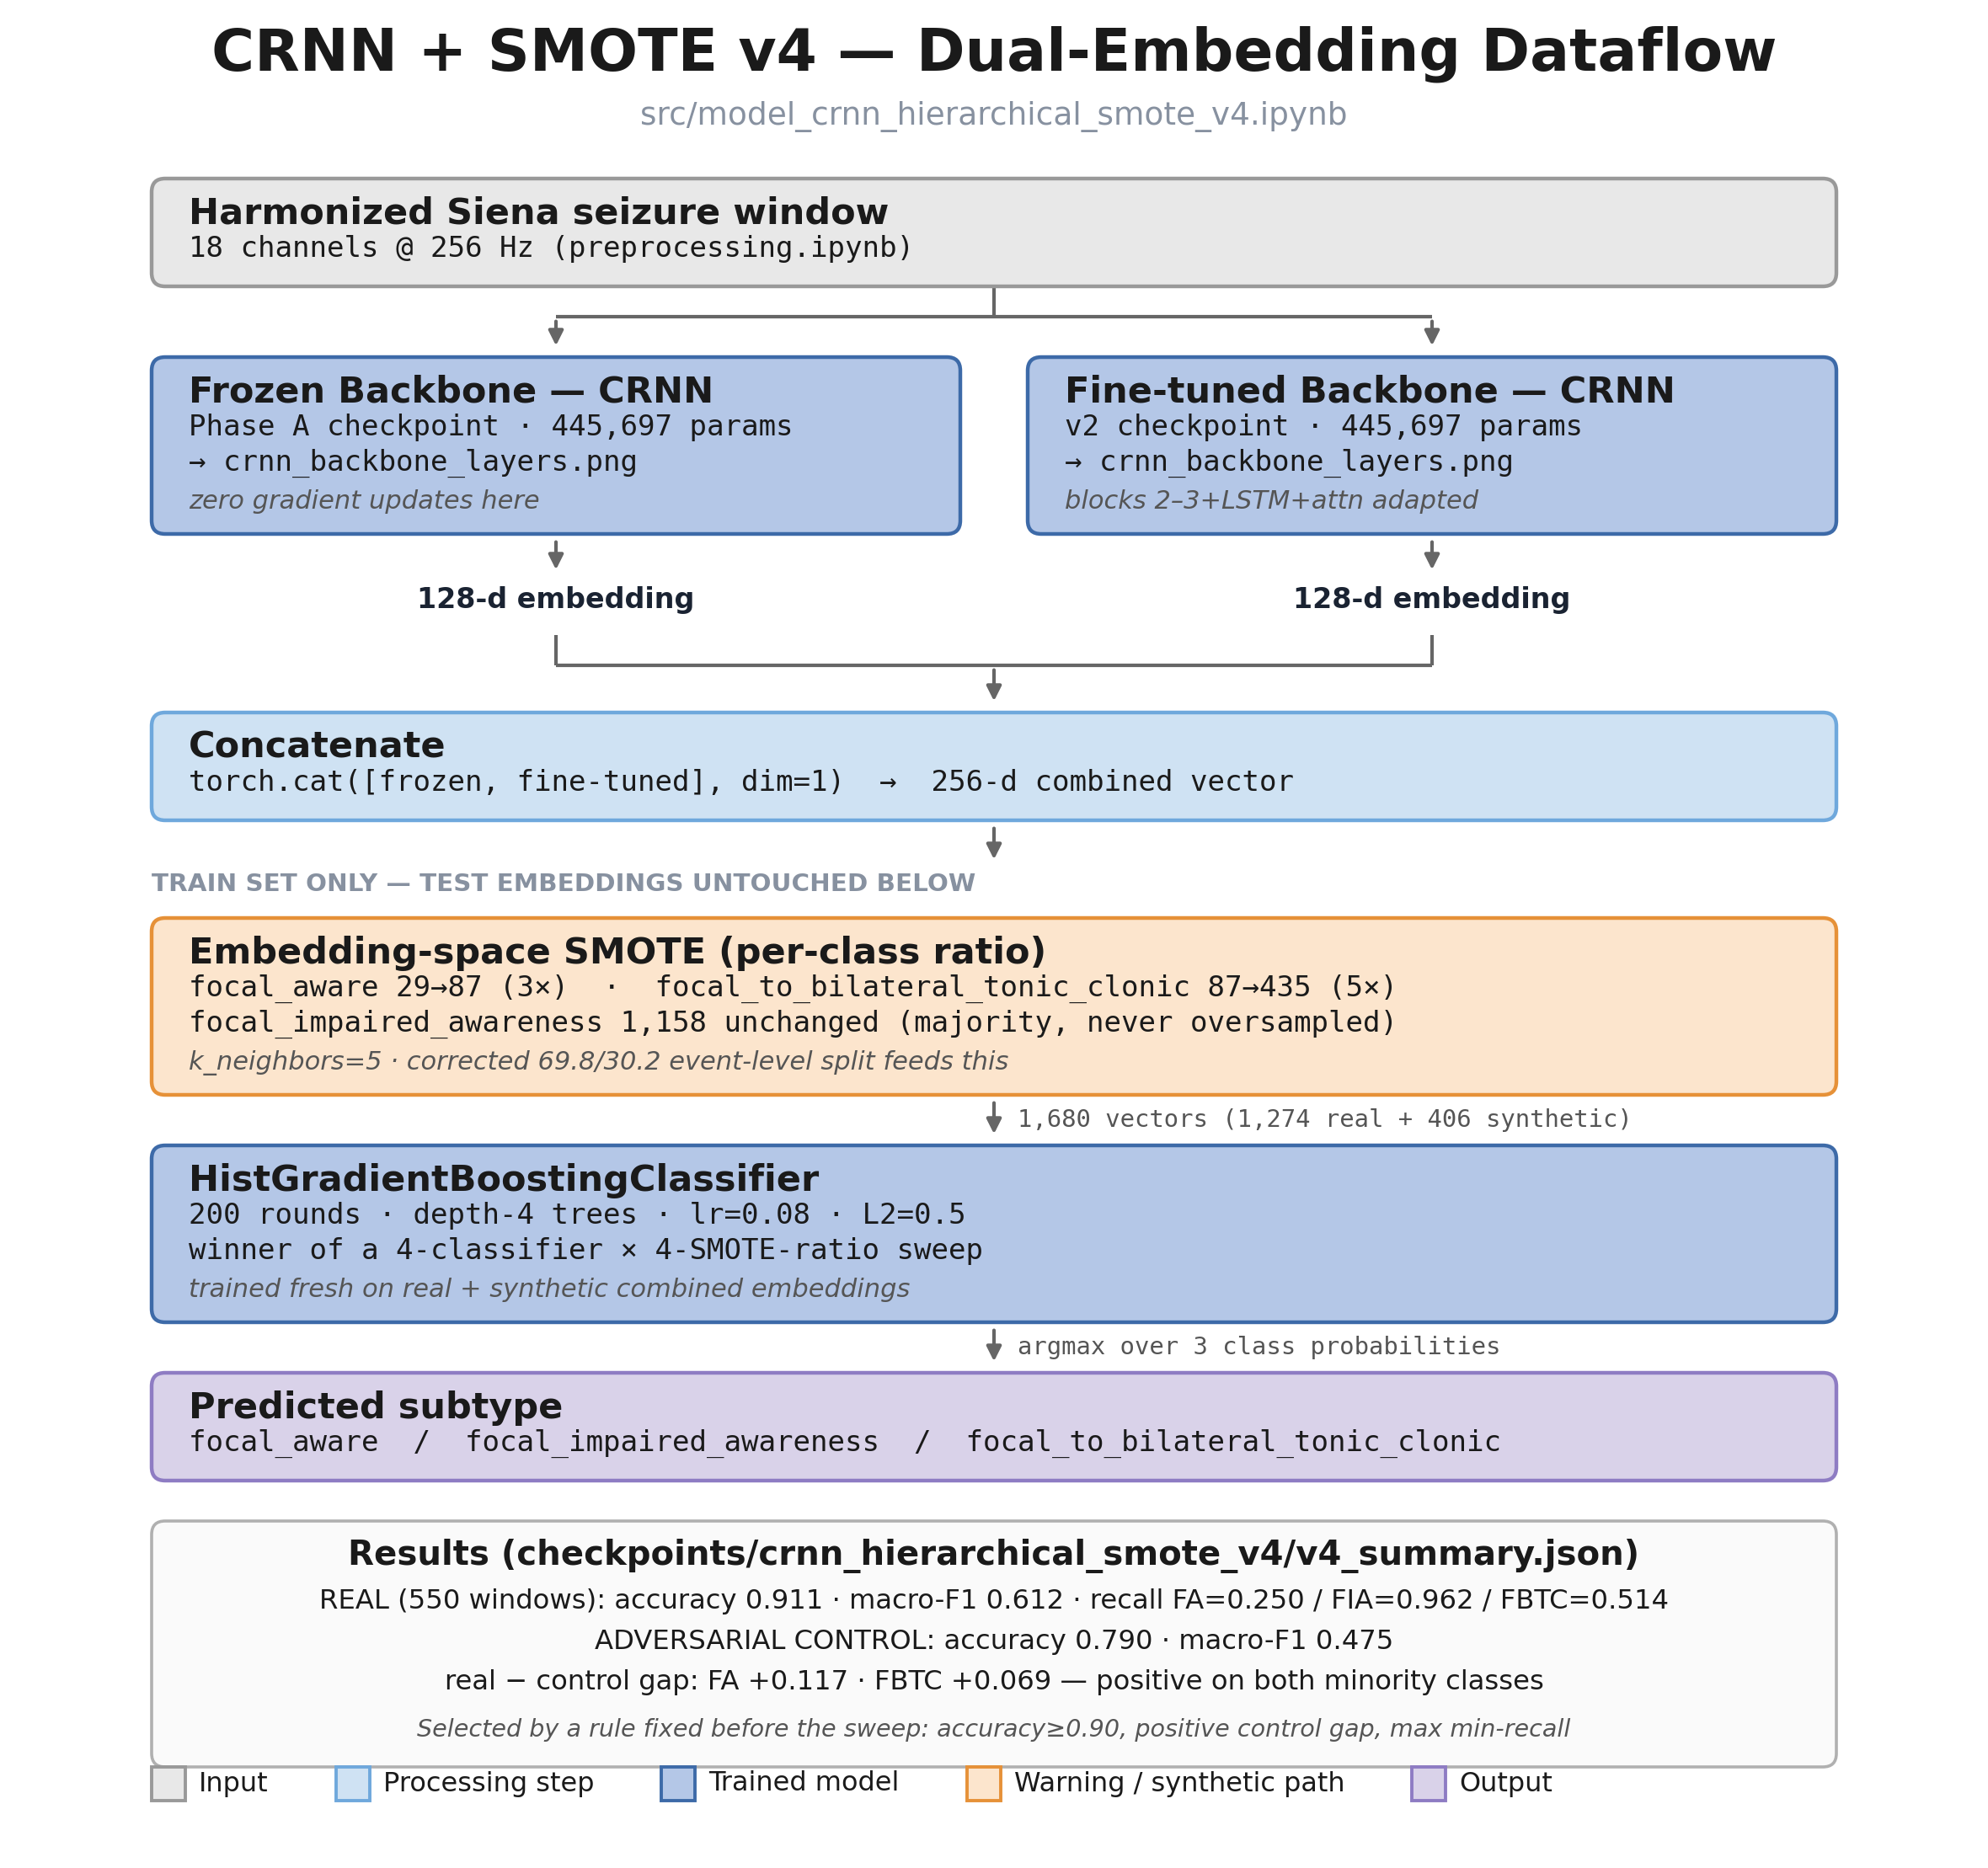
Proposed Model: EEG-HDC v4 Dataflow
Input: harmonized 18-channel, 256 Hz Siena seizure window.
Two CRNN backbones (445,697 parameters each) give 128-D embeddings.
256-D concatenation; SMOTE on the training split only (test embeddings untouched).
HistGradientBoosting: 200 rounds, depth 4, learning rate 0.08, L2 = 0.5.
Output: argmax over 3 subtype probabilities.
Notes:
This is the actual dataflow of the final model, top to bottom.
An 18-channel EEG window enters two copies of the CRNN. The left copy is frozen from Phase A, the right one is the fine-tuned version. Each outputs 128 numbers.
They are concatenated into 256 numbers. On the training set only, SMOTE adds synthetic examples: Focal Aware goes from 29 to 87 and FBTC from 87 to 435. Test data is never touched.
A HistGradientBoosting classifier (200 small trees, depth 4, learning rate 0.08) is trained on these. At prediction time it outputs three probabilities and we pick the highest.
The box at the bottom of the picture shows the final numbers: accuracy 0.911 and macro-F1 0.612.

Slide 23
Latent-Space SMOTE & Model Selection
Why latent space: interpolating raw EEG creates non-physiological phase and frequency artifacts; interpolating learned embeddings does not.
Class-adaptive ratios (k = 5 neighbors): Focal Aware 29 → 87 (3×), FBTC 87 → 435 (5×); Focal Impaired Awareness (1,158) never oversampled.
Classifier sweep: MLP, Random Forest and HistGradientBoosting.
Adversarial control: 150 interictal windows per patient, re-labelled with that patient’s subtype, run through the same pipeline. Recall gap Δ = real − control.
Selection rule (fixed before the sweep): accuracy ≥ 0.90, positive Δ on both minority classes, then maximize the minimum class recall.
Notes:
SMOTE means synthetic minority oversampling: create new rare-class examples by interpolating between a real example and a close neighbour. The formula is z_new = z_i + lambda times (z_neighbour minus z_i), lambda random between 0 and 1.
We do it on the 256-number embeddings, not on the raw EEG, because mixing two raw brain signals gives signals that no brain makes.
We tried 3 classifiers (MLP, Random Forest, HistGB) times 3 ratio settings: 9 combinations.
The adversarial control checks whether the model is cheating by recognising the patient. We take normal EEG from each patient, label it with that patient's seizure type and test. A good model should do worse here than on real seizures; the difference is the gap.
The winner was chosen by a rule fixed before running the experiments: accuracy at least 0.90, positive gap on both rare classes, then best worst-class recall. This avoids picking results after seeing them.

Slide 24
Models Compared
 | 1D-CNN (LOSO) | Fine-tuned CRNN (v2) | EEG-HDC v4 (Proposed)
Backbone | 5-block 1D-CNN, from scratch | CRNN, Phase A weights fine-tuned | Two CRNN backbones (frozen + fine-tuned)
Features | Learned end-to-end | 128-D embedding | 256-D dual embedding
Imbalance handling | Class weights | Embedding SMOTE (3× / 5×) | Embedding SMOTE (3× / 5×)
Classifier | Softmax head | MLP head | HistGradientBoosting
Evaluation split | Leave-one-subject-out (13 folds) | Event-level stratified (70/30) | Event-level stratified (70/30)
The LOSO baseline is a stricter test (unseen patients); v2 and v4 share the same event-level split and are directly comparable.
Notes:
We compare three models so the improvement is clear.
1) 1D-CNN baseline: a plain convolutional network trained from scratch, tested leave-one-patient-out (every patient is held out in turn). This is the strictest test.
2) Fine-tuned CRNN (v2): our CRNN with Phase A weights fine-tuned, plus SMOTE.
3) EEG-HDC v4 (proposed): two backbones, 256 numbers, SMOTE, HistGB.
Be honest about the caveat at the bottom: the baseline is judged on unseen patients, while v2 and v4 use the same event-level split, so v2 versus v4 is a fair comparison and baseline versus the others is not perfectly like for like.

Slide 25
Implementation Technology
Training: PyTorch (CRNN backbones), scikit-learn (SMOTE-balanced classifiers), MNE / HDF5 for EEG preprocessing.
Inference path: 4 s windows → Stage 1 detector → threshold + minimum event duration → 10 s event windows → dual-embedding HistGB subtype with per-class probabilities.
Notes:
The models are built in PyTorch and scikit-learn, with MNE and HDF5 for handling EEG files.
We also built a web app called NeuroScan. A user uploads a raw .edf EEG file. The app cuts it into 4-second windows, runs the detector, merges flagged windows into seizure events, then classifies each event using the v4 model. It shows the 18 channels like an oscilloscope with seizures highlighted and bars for the probability of each subtype.
Backend is Flask and the plots use Plotly.js. This shows the model can be used end to end, not just in a notebook.

Slide 26
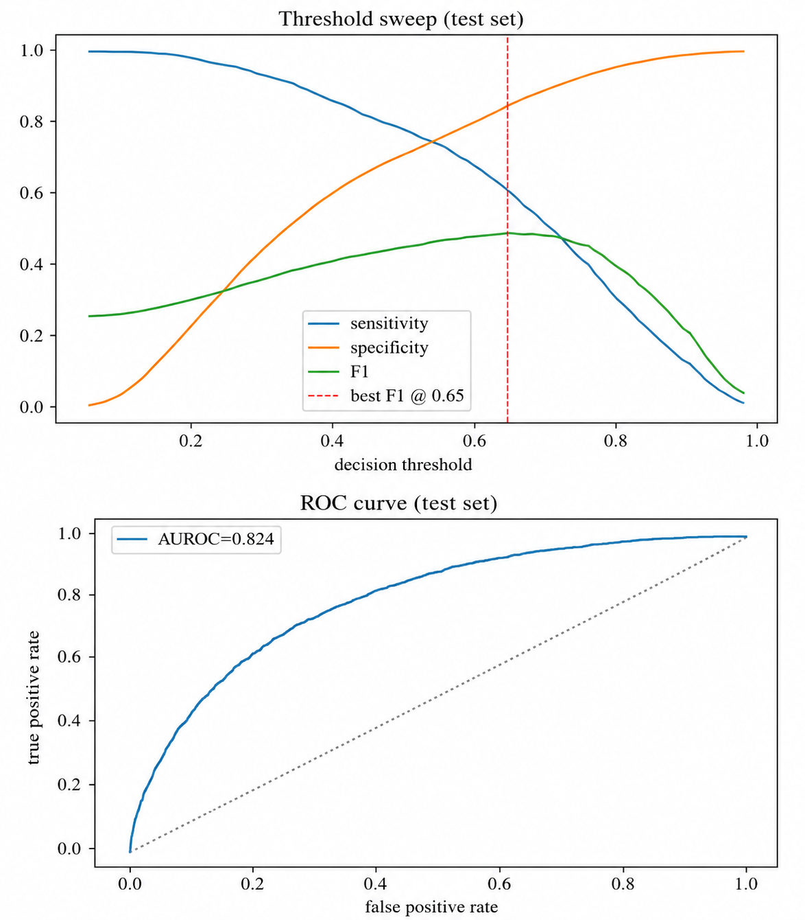
Results: Seizure Detection (Stage 1)
Metric | 1D-CNN | CRNN (Phase A)
Test AUROC | 0.851 | 0.824
Best threshold | 0.73 | 0.65
Sensitivity | 0.525 | 0.605
Specificity | 0.920 | 0.852
F1 score | 0.526 | 0.487
Held-out test patients, never seen in training.
The two detectors are comparable (~0.82–0.85 AUROC); the CRNN trades specificity for higher sensitivity.
Notes:
Left: the top graph shows how sensitivity (seizures found), specificity (non-seizures correctly ignored) and F1 change as we move the decision threshold. The best F1 is at 0.65. The bottom graph is the ROC curve; the closer to the top-left corner, the better. Area under it (AUROC) is 0.824; 0.5 would be guessing and 1.0 perfect.
Right: the plain 1D-CNN gets AUROC 0.851 and the CRNN 0.824. They are about the same; the CRNN finds more seizures (sensitivity 0.605 versus 0.525) but raises more false alarms.
Important: these are on patients never seen in training. Note this is the corrected value from the saved results. The paper draft had a different number.

Slide 27
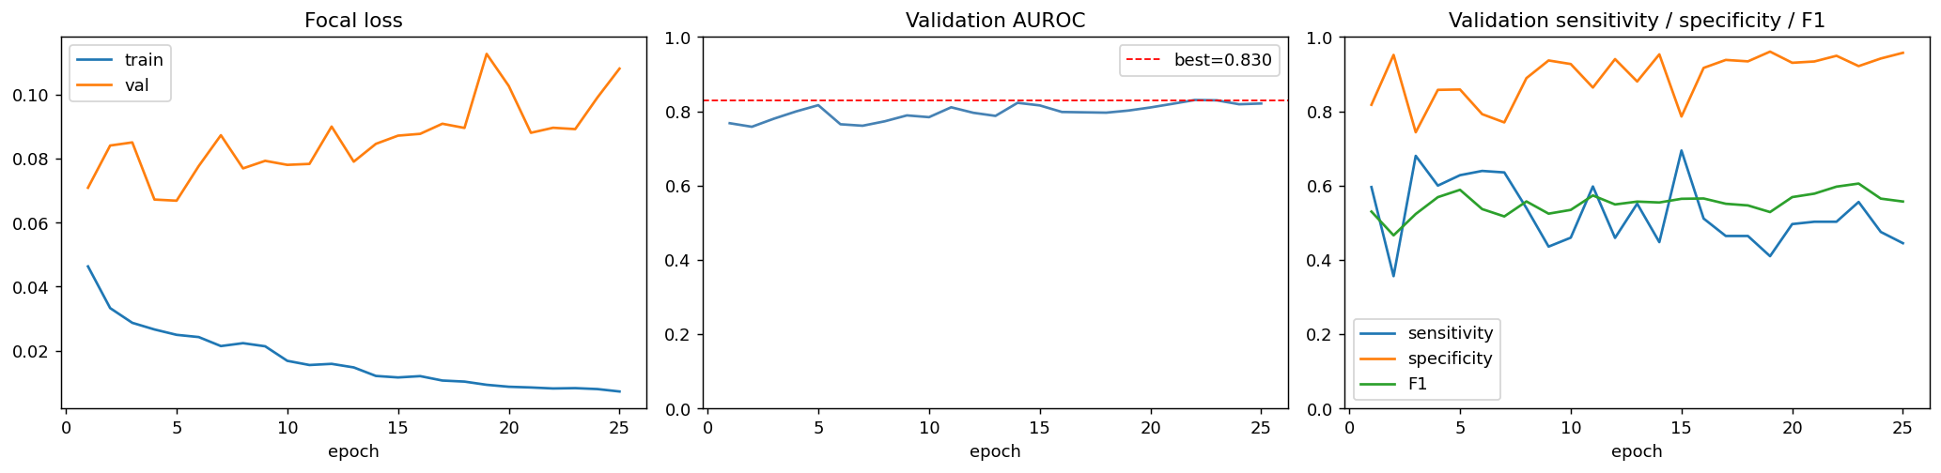
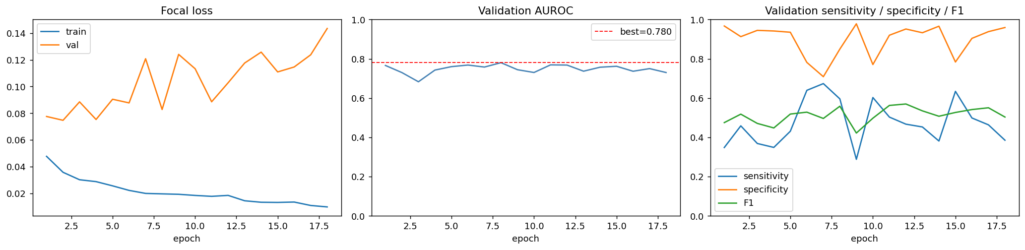
Results: Training Curves
CRNN (Phase A): focal loss, validation AUROC (best 0.830) and sensitivity / specificity / F1
1D-CNN (Stage 1): training curves for comparison
Notes:
These show how learning went epoch by epoch for the CRNN (top) and the plain CNN (bottom).
Left panel: training loss keeps falling, validation loss does not. That tells us the model starts to memorise training data, so we keep the best checkpoint rather than the last one.
Middle: validation AUROC peaks around 0.83 and stays flat. Right: sensitivity, specificity and F1 jump around because the validation patients are few.
Takeaway: more training does not help much; the limit is the data, not the training time.

Slide 28
Results: Classifier & SMOTE Sweep
Classifier | SMOTE FA/FBTC | Acc. | Macro-F1 | Rec. FA | Rec. FIA | Rec. FBTC | Δ FA | Δ FBTC
MLP | 3× / 3× | 0.905 | 0.534 | 0.000 | 0.966 | 0.486 | 0.000 | +0.486
MLP | 3× / 5× | 0.907 | 0.535 | 0.000 | 0.968 | 0.486 | 0.000 | +0.131
MLP | 5× / 5× | 0.905 | 0.534 | 0.000 | 0.966 | 0.486 | 0.000 | +0.086
Random Forest | 3× / 3× | 0.891 | 0.497 | 0.000 | 0.958 | 0.378 | −0.467 | −0.199
Random Forest | 3× / 5× | 0.891 | 0.497 | 0.000 | 0.958 | 0.378 | −0.489 | −0.199
Random Forest | 5× / 5× | 0.896 | 0.507 | 0.000 | 0.962 | 0.405 | −0.533 | −0.172
HistGB | 3× / 3× | 0.905 | 0.529 | 0.062 | 0.970 | 0.405 | −0.049 | +0.028
HistGB (Winner) | 3× / 5× | 0.911 | 0.612 | 0.250 | 0.962 | 0.514 | +0.117 | +0.069
HistGB | 5× / 5× | 0.913 | 0.596 | 0.125 | 0.962 | 0.595 | −0.008 | +0.172
MLP and Random Forest never recover Focal Aware; Random Forest shows negative control gaps (patient-identity shortcut).
HistGB 3×/5× is the only configuration meeting every selection criterion.
Notes:
This table is the experiment where we tried three classifiers with three SMOTE settings.
Look at the Rec. FA column: MLP and Random Forest are 0.000, they never find Focal Aware. Look at the last two columns, the control gaps: Random Forest is strongly negative, a sign it is mostly recognising the patient.
Only the highlighted row, HistGB with 3x FA and 5x FBTC oversampling, meets all rules: accuracy 0.911, macro-F1 0.612, FA recall 0.25, FBTC recall 0.514, and positive gaps for both.
Also mention: the nearby HistGB 5x/5x has higher FBTC recall but negative FA gap, so it was rejected by our rule.

Slide 29
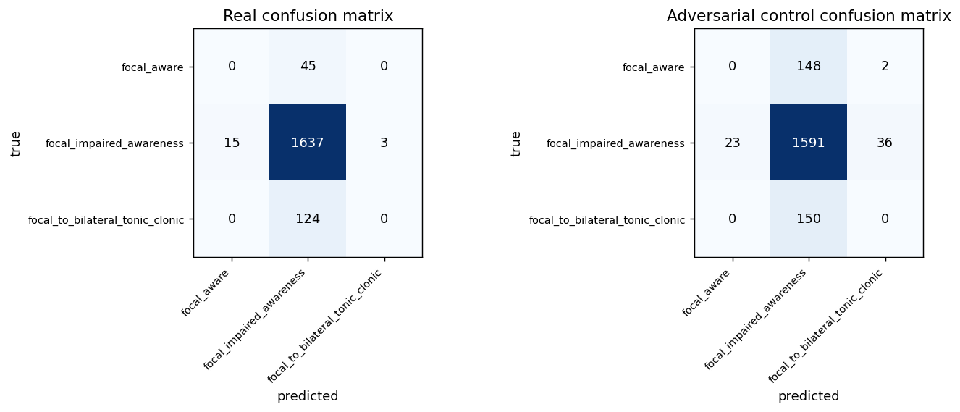
Confusion Matrices: 1D-CNN Baseline (LOSO)
Left: real seizure windows Right: adversarial interictal control
Test windows: 1,824 across 13 held-out patients; accuracy 0.897, macro-F1 0.315.
Only the majority class is recognised: FA recall 0 / 45, FBTC recall 0 / 124.
Notes:
How to read a confusion matrix: rows are the true class, columns are what the model predicted; the diagonal is correct.
Left (real seizures): almost everything is predicted as Focal Impaired Awareness. 1,637 FIA are right, but all 45 Focal Aware and all 124 FBTC windows are wrong.
Right is the control test (normal EEG with fake labels); it behaves the same way.
Accuracy is 0.897 but only because the majority class dominates. This model has effectively learned to say FIA every time. That is exactly the problem we set out to fix.

Slide 30
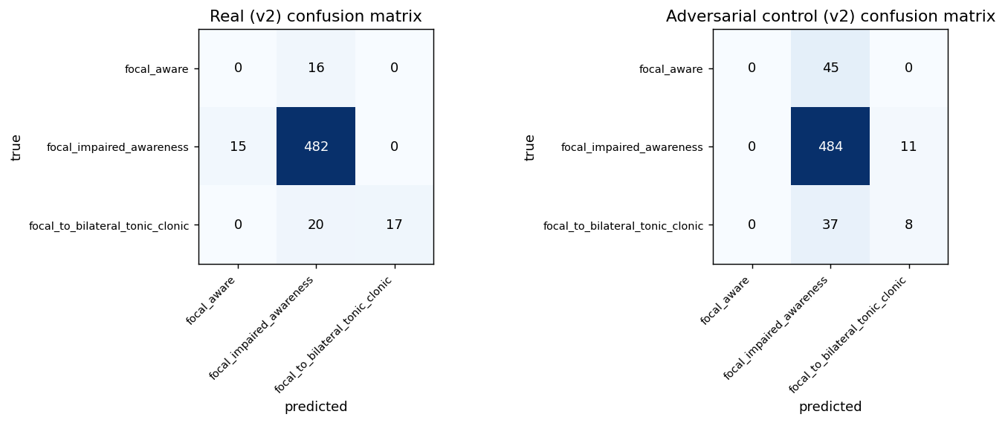
Confusion Matrices: Fine-tuned CRNN (v2)
Left: real seizure windows Right: adversarial interictal control
Test windows: 550; accuracy 0.907, macro-F1 0.526.
FBTC recall rises to 17 / 37 (45.9 %), but Focal Aware is still missed (0 / 16).
Notes:
Here we test on 550 windows. Fine-tuning helps FBTC: 17 of 37 are now correct (45.9%).
Focal Aware is still missed completely: 0 of 16.
Look at the control matrix on the right: FBTC is found only 8 of 45 times on the fake-labelled data, so the FBTC detection is real, not patient recognition. Good sign, but Focal Aware is still invisible to this model.

Slide 31
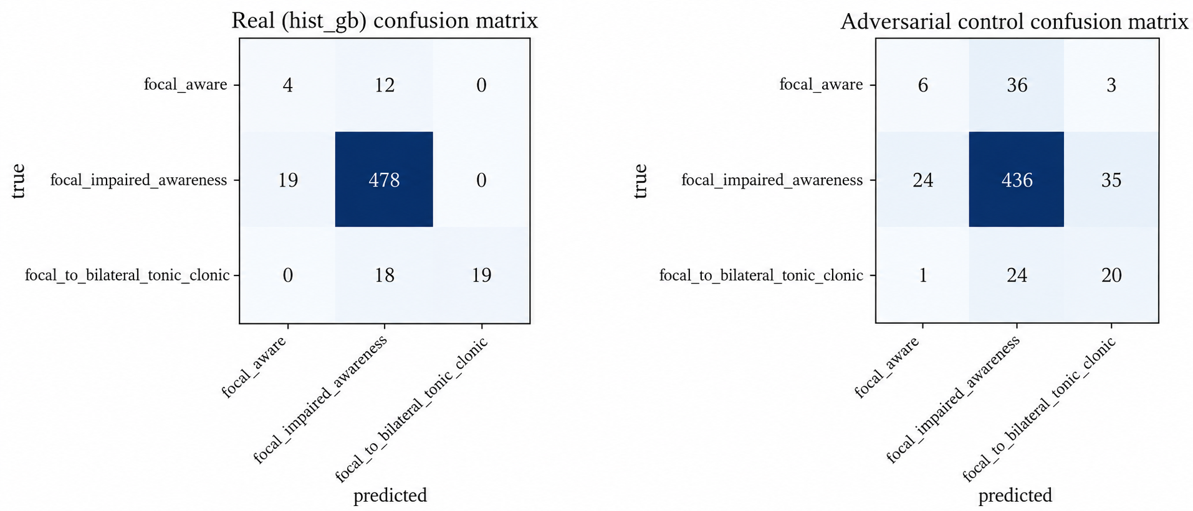
Confusion Matrices: EEG-HDC v4 (Proposed)
Left: real seizure windows Right: adversarial interictal control
Test windows: 550; accuracy 0.911, macro-F1 0.612.
Recall: FA 4 / 16 (25.0 %), FIA 478 / 497 (96.2 %), FBTC 19 / 37 (51.4 %) – the first model to recognise all three subtypes.
Notes:
This is our best model, same 550 test windows.
Focal Aware: 4 of 16 correct (25%). Focal Impaired Awareness: 478 of 497 (96.2%). FBTC: 19 of 37 (51.4%).
It is the only model that finds all three types.
Right side, the control: on fake-labelled normal EEG the model finds FA only 6 of 45 times and FBTC 20 of 45 times, lower than on real seizures, so the model is responding to real seizure patterns. The gaps are +0.117 for FA and +0.069 for FBTC.
Be honest that 4 out of 16 is small numbers and the improvement on FA is modest but real.

Slide 32
Comparison: Per-Class Recall
v4 is the only model with non-zero recall on every subtype, at the same overall accuracy (~0.91).
Gains on minority classes cost under 3 points of FIA recall.
Notes:
Recall means: of the windows that truly belong to a class, what fraction did we find.
The bars show the three models side by side. All find nearly all FIA (the common class). For Focal Aware only v4 has a bar (0.25). For FBTC, v2 gets 0.46 and v4 gets 0.51; the baseline gets 0.
The cost of this gain is tiny: FIA recall goes from 0.99 to 0.96. We trade a little on the majority class to gain on rare classes, which is what a doctor wants.

Slide 33
Comparison: Overall Metrics
Model | Real Acc. | Real Macro-F1 | Control Acc. | Control Macro-F1 | Δ FA | Δ FBTC
1D-CNN (LOSO) | 0.897 | 0.315 | 0.816 | 0.300 | 0.000 | 0.000
Fine-tuned CRNN (v2) | 0.907 | 0.526 | 0.841 | 0.387 | 0.000 | +0.281
EEG-HDC v4 (Proposed) | 0.911 | 0.612 | 0.790 | 0.475 | +0.117 | +0.069
Macro-F1 doubles from the LOSO baseline (0.315) to v4 (0.612).
v2 has the larger FBTC gap but no Focal Aware signal; v4 is the only model with a positive gap on both minority classes.
Control = interictal windows relabelled with each patient’s subtype; a high control score means patient recognition rather than seizure recognition.
Notes:
Summary table of the three models. Real columns are on genuine seizures; control columns are on the fake-labelled normal EEG.
Real accuracy is about the same (0.90 to 0.91), so accuracy alone hides the difference. Macro-F1, which averages the three classes equally, goes from 0.315 to 0.526 to 0.612.
Gap columns: v4 is the only model with positive gaps on both rare classes. v2 has a bigger FBTC gap but no Focal Aware signal at all, so it cannot be called a three-class solution.

Slide 34
Adversarial Control: Recall Gap
Gap = real recall minus control recall; a positive gap means the classifier responds to seizure dynamics, not to the patient’s background EEG.
Random Forest is strongly negative on both classes: its decisions are dominated by patient identity.
Configuration shown: SMOTE 3× FA / 5× FBTC.
Notes:
Gap equals recall on real seizures minus recall on the control. Positive is good.
Random Forest is negative on both (minus 0.49 and minus 0.20): it did better on fake-labelled normal EEG than on real seizures, meaning it was recognising patients.
MLP has gap zero on Focal Aware simply because it never predicts that class.
HistGB, our model, is positive on both. This chart is our evidence that the final model is not cheating.

Slide 35
Model Evolution Across Versions
v1 (embedding SMOTE) recovers Focal Aware (13 / 16) but never FBTC (0 / 56); v2 (fine-tuned) recovers FBTC but loses FA.
v3 (frozen detection backbone only) recovers FA but accuracy drops to 0.573.
v4 fuses both views: highest macro-F1 (0.612) with accuracy above 0.91.
Notes:
This shows how the idea developed. Grey bars are accuracy, red bars are macro-F1.
Baseline: accuracy 0.90, macro-F1 0.32. v1 (SMOTE on embeddings): finds Focal Aware (13 of 16) but no FBTC. v2 (fine-tuned): finds FBTC but loses FA. v3 (frozen detector only, SVM): finds FA but accuracy collapses to 0.57. v4 (both backbones): best macro-F1, 0.612, with accuracy 0.91.
Message: each version fixed one weakness and exposed another; combining the two views solved both.

Slide 36
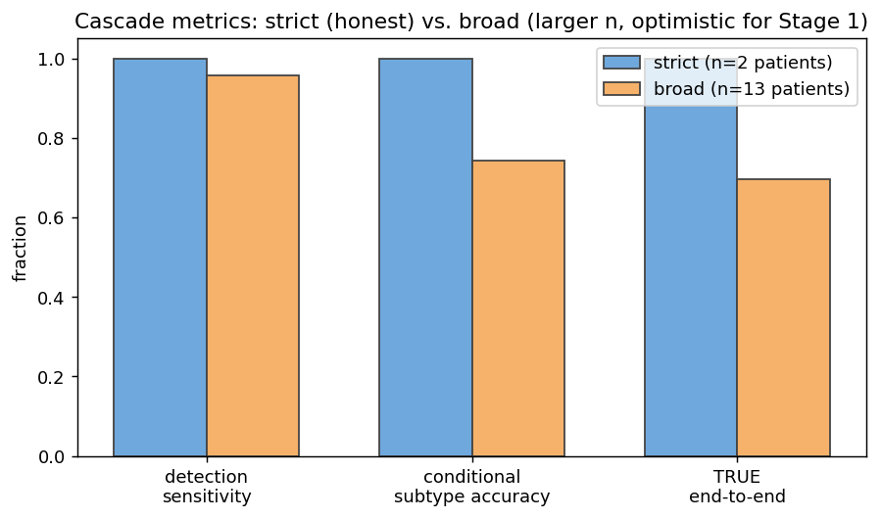
Results: End-to-End Cascade (CNN Stage 1 + Stage 2)
 | Sens. | Cond. Acc. | End-to-end | n
Strict (2 patients) | 1.00 | 1.00 | 1.00 | 4
Broad (13 patients) | 0.957 | 0.744 | 0.696 | 46
Strict = patients unseen by both stages; broad is optimistic for Stage 1.
Strict result is only 4 events and is not statistically solid.
This cascade chains the earlier independent CNNs; it is the end-to-end reference for the hierarchy idea.
Notes:
This is an earlier test of the full detect-then-classify pipeline using the two plain CNNs, to check that chaining the stages works.
Strict means only the 2 patients that neither stage saw in training: everything was correct, but that is only 4 events, so it is not statistically strong.
Broad uses all 13 patients (46 events): 95.7% of seizures detected, 74.4% of those correctly classified, so 69.6% correct end to end. This number is optimistic for the detection part because most patients were in its training data.
It shows the two-stage design works in principle.

Slide 37
Limitations & Future Enhancements
Extreme data scarcity: Focal Aware and FBTC come from one Siena patient each; the FA test set has only 16 windows (4 correct).
v2 / v4 use an event-level split, so the same patient appears in train and test; this is weaker than patient-independent generalization.
Detection is moderate (AUROC 0.824, sensitivity 0.605 at the best-F1 threshold); window-level only, with no temporal smoothing.
FA recall of 25 % and FBTC recall of 51 % are not yet clinically sufficient.
Only the three focal subtypes are covered; no prospective or clinical validation.
Future: more multi-patient subtype data (e.g. TUSZ), true patient-independent evaluation, rare generalized subtypes, event-level smoothing and real-time deployment.
Notes:
Be upfront about limits.
Data: Focal Aware and FBTC come from one patient each; our FA test has 16 windows, so 4 correct is a small sample.
Evaluation: v2 and v4 split by seizure event, so the same patient appears in both training and testing. That is easier than testing on brand-new patients.
Detection is moderate (AUROC 0.824) and works window by window without smoothing.
Clinically, 25% and 51% recall are not sufficient yet. Only three focal subtypes are covered.
Future: add more patients and datasets (for example TUSZ), evaluate on unseen patients, add rarer seizure types, smooth predictions over time and deploy in real time.

Slide 38
Conclusion
EEG-HDC v4 combines a standardized 18-channel preprocessing pipeline with a dual-embedding CRNN (128-D frozen + 128-D fine-tuned = 256-D).
Latent-space SMOTE handles severe subtype imbalance without corrupting raw EEG.
Best configuration (HistGB, 3× FA / 5× FBTC): accuracy 0.911, macro-F1 0.612, recall FA 25.0 %, FIA 96.2 %, FBTC 51.4 %.
Positive control gaps on both minority classes (ΔFA = +0.117, ΔFBTC = +0.069) indicate the model is not merely recognising patients.
Macro-F1 improves from 0.315 (1D-CNN baseline) to 0.612 and v4 is the only model that detects all three subtypes.
Notes:
To wrap up. We built EEG-HDC v4, a two-stage system: detect seizures, then classify the type.
The new ideas: use two backbones (one frozen, one fine-tuned) and join their outputs into 256 numbers; balance rare classes with SMOTE in that feature space; verify with an adversarial control that the model is not just recognising patients.
Results: accuracy 0.911 and macro-F1 0.612, up from 0.315 for the baseline, with recall of 25% for Focal Aware, 96.2% for FIA and 51.4% for FBTC, and it is the only model that finds all three.
It is a solid step, limited mainly by the amount of labelled data.

Slide 39
References
[1] N. Ilakiyaselvan, A. N. Khan, and A. Shahina, “Deep learning approach to detect seizure using reconstructed phase space images,” J. Biomed. Res., vol. 34, no. 3, p. 240, 2020.
[2] S. Srinivasan, S. Dayalane, S. K. Mathivanan, H. Rajadurai, P. Jayagopal, and G. T. Dalu, “Detection and classification of adult epilepsy using hybrid deep learning approach,” Sci. Rep., vol. 13, no. 1, Art. no. 17574, Oct. 2023.
[3] H. Albaqami, G. M. Hassan, and A. Datta, “Wavelet-based multi-class seizure type classification system,” Appl. Sci., vol. 12, no. 11, Art. no. 5702, Jun. 2022.
[4] A. Abdelhameed and M. Bayoumi, “A deep learning approach for automatic seizure detection in children with epilepsy,” Front. Comput. Neurosci., vol. 15, Art. no. 650050, Apr. 2021.
[5] M. Guendelman, R. Vekslar, and O. Shriki, “A new perspective in epileptic seizure classification: Applying the taxonomy of seizure dynamotypes to non-invasive EEG and examining dynamical changes across sleep stages,” eNeuro, vol. 12, no. 1, Art. no. ENEURO.0157-24.2024, Jan. 2025.
Notes:
References in IEEE format. They include the 45 papers from the literature survey, plus the datasets (Siena and CHB-MIT), the ILAE seizure classification, ChronoNet and the shortcut-learning paper that our methodology builds on. No need to read these out.

Slide 40
References
[6] M. K. Siddiqui, R. Morales-Menendez, X. Huang, and N. Hussain, “A review of epileptic seizure detection using machine learning classifiers,” Brain Inform., vol. 7, no. 1, p. 5, May 2020.
[7] Y. Yuan et al., “A transformer-based framework with data augmentation for robust seizure detection across invasive and non-invasive neural recordings,” CNS Neurosci. Ther., vol. 31, no. 9, Art. no. e70584, Sep. 2025.
[8] P. A. Akor, G. Enemali, U. Muhammad, R. R. Singh, and H. Larijani, “An attention-residual convolutional network for real-time seizure classification on edge devices,” Sensors, vol. 25, no. 22, Art. no. 6855, Nov. 2025.
[9] A. Ulate-Campos, F. Coughlin, M. Gaínza-Lein, I. S. Fernández, P. L. Pearl, and T. Loddenkemper, “Automated seizure detection systems and their effectiveness for each type of seizure,” Seizure, vol. 40, pp. 88–101, Aug. 2016.
[10] U. R. Acharya, Y. Hagiwara, and H. Adeli, “Automated seizure prediction,” Epilepsy Behav., vol. 88, pp. 251–261, Nov. 2018.
Notes:
References in IEEE format. They include the 45 papers from the literature survey, plus the datasets (Siena and CHB-MIT), the ILAE seizure classification, ChronoNet and the shortcut-learning paper that our methodology builds on. No need to read these out.

Slide 41
References
[11] X. Wei, L. Zhou, Z. Chen, L. Zhang, and Y. Zhou, “Automatic seizure detection using three-dimensional CNN based on multi-channel EEG,” BMC Med. Inform. Decis. Mak., vol. 18, no. S5, Art. no. 111, Dec. 2018.
[12] R. San-Segundo, M. Gil-Martín, L. F. D’Haro-Enríquez, and J. M. Pardo, “Classification of epileptic EEG recordings using signal transforms and convolutional neural networks,” Comput. Biol. Med., vol. 109, pp. 148–158, Jun. 2019.
[13] Y. Wang, Y. Shi, Z. He, Z. Chen, and Y. Zhou, “Combining temporal and spatial attention for seizure prediction,” Health Inf. Sci. Syst., vol. 11, no. 1, Art. no. 38, Aug. 2023.
[14] L. Bai, G. Litscher, and X. Li, “Epileptic seizure detection using machine learning: A systematic review and meta-analysis,” Brain Sci., vol. 15, no. 6, Art. no. 634, Jun. 2025.
[15] I. Jemal, L. Abou-Abbas, K. Henni, A. Mitiche, and N. Mezghani, “Domain adaptation for EEG-based, cross-subject epileptic seizure prediction,” Front. Neuroinform., vol. 18, Art. no. 1303380, Feb. 2024.
Notes:
References in IEEE format. They include the 45 papers from the literature survey, plus the datasets (Siena and CHB-MIT), the ILAE seizure classification, ChronoNet and the shortcut-learning paper that our methodology builds on. No need to read these out.

Slide 42
References
[16] B. P. Prathaban and R. Balasubramanian, “Dynamic learning framework for epileptic seizure prediction using sparsity based EEG reconstruction with optimized CNN classifier,” Expert Syst. Appl., vol. 170, Art. no. 114533, May 2021.
[17] S. Raghu, N. Sriraam, Y. Temel, S. V. Rao, and P. L. Kubben, “EEG based multi-class seizure type classification using convolutional neural network and transfer learning,” Neural Netw., vol. 124, pp. 202–212, Apr. 2020.
[18] S. Wong et al., “EEG datasets for seizure detection and prediction—A review,” Epilepsia Open, vol. 8, no. 2, pp. 252–267, Jun. 2023.
[19] A. A. Ein Shoka, M. M. Dessouky, A. El-Sayed, and E. E.-D. Hemdan, “EEG seizure detection: Concepts, techniques, challenges, and future trends,” Multimed. Tools Appl., vol. 82, no. 27, pp. 42021–42051, 2023.
[20] W. Cao, Q. Li, A. Zhang, and T. Wang, “Efficient and accurate epilepsy seizure prediction and detection based on multi-teacher knowledge distillation RGF-model,” Brain Sci., vol. 16, no. 1, Art. no. 83, Jan. 2026.
Notes:
References in IEEE format. They include the 45 papers from the literature survey, plus the datasets (Siena and CHB-MIT), the ILAE seizure classification, ChronoNet and the shortcut-learning paper that our methodology builds on. No need to read these out.

Slide 43
References
[21] N. McCallan et al., “Epileptic multi-seizure type classification using electroencephalogram signals from the Temple University Hospital Seizure Corpus: A review,” Expert Syst. Appl., vol. 234, Art. no. 121040, Dec. 2023.
[22] M. Zhou et al., “Epileptic seizure detection based on EEG signals and CNN,” Front. Neuroinform., vol. 12, Art. no. 95, Dec. 2018.
[23] A. T. Tzallas, M. G. Tsipouras, and D. I. Fotiadis, “Epileptic seizure detection in EEGs using time–frequency analysis,” IEEE Trans. Inf. Technol. Biomed., vol. 13, no. 5, pp. 703–710, Sep. 2009.
[24] A. Subasi, J. Kevric, and M. Abdullah Canbaz, “Epileptic seizure detection using hybrid machine learning methods,” Neural Comput. Appl., vol. 31, no. 1, pp. 317–325, 2019.
[25] M. S. Farooq, A. Zulfiqar, and S. Riaz, “Epileptic seizure detection using machine learning: Taxonomy, opportunities, and challenges,” Diagnostics, vol. 13, no. 6, Art. no. 1058, Mar. 2023.
Notes:
References in IEEE format. They include the 45 papers from the literature survey, plus the datasets (Siena and CHB-MIT), the ILAE seizure classification, ChronoNet and the shortcut-learning paper that our methodology builds on. No need to read these out.

Slide 44
References
[26] E. Ali, M. Angelova, and C. Karmakar, “Epileptic seizure detection using CHB-MIT dataset: The overlooked perspectives,” R. Soc. Open Sci., vol. 11, no. 3, 2024.
[27] A. Shoeibi et al., “Epileptic seizures detection using deep learning techniques: A review,” Int. J. Environ. Res. Public Health, vol. 18, no. 11, Art. no. 5780, May 2021.
[28] T. K. Murugan and A. Kameswaran, “Employing convolutional neural networks and explainable artificial intelligence for the detection of seizures from electroencephalogram signal,” Results Eng., vol. 24, Art. no. 103378, Dec. 2024.
[29] S. Cuyckens, R. Antonio, C. Fang, and M. Verhelst, “iEEG seizure detection with a sparse hyperdimensional computing accelerator,” in Proc. IEEE Int. Symp. Circuits Syst. (ISCAS), 2023.
[30] P. Thodoroff, J. Pineau, and A. Lim, “Learning robust features using deep learning for automatic seizure detection,” in Proc. Mach. Learn. Healthcare Conf. (MLHC), vol. 56, 2016, pp. 178–190.
Notes:
References in IEEE format. They include the 45 papers from the literature survey, plus the datasets (Siena and CHB-MIT), the ILAE seizure classification, ChronoNet and the shortcut-learning paper that our methodology builds on. No need to read these out.

Slide 45
References
[31] T. Sverrisson and S. Gudmundsson, “LookAroundNet: Extending temporal context with transformers for clinically viable EEG seizure detection,” arXiv preprint, 2025.
[32] G. Giannakakis, V. Sakkalis, M. Pediaditis, and M. Tsiknakis, “Methods for seizure detection and prediction: An overview,” in Modern Electroencephalographic Assessment Techniques (Neuromethods, vol. 91). New York, NY, USA: Springer, 2015, pp. 131–157.
[33] Y. Yang, K. Guo, Z. Fang, H. Lin, M. Grosser, and J. Lu, “Multi-model transfer learning and genotypic analysis for seizure type classification,” in Lecture Notes in Computer Science. Springer, 2023, pp. 223–234.
[34] D. Ahmedt-Aristizabal, T. Fernando, S. Denman, L. Petersson, M. J. Aburn, and C. Fookes, “Neural memory networks for seizure type classification,” in Proc. 42nd Annu. Int. Conf. IEEE Eng. Med. Biol. Soc. (EMBC), Jul. 2020, pp. 569–575.
[35] S. Ghosh, V. Singh, and O. S. Powar, “Seizure detection using EEG on the CHB-MIT dataset via multi-domain feature engineering and classical machine learning,” Discov. Appl. Sci., vol. 8, no. 3, Art. no. 312, 2026.
Notes:
References in IEEE format. They include the 45 papers from the literature survey, plus the datasets (Siena and CHB-MIT), the ILAE seizure classification, ChronoNet and the shortcut-learning paper that our methodology builds on. No need to read these out.

Slide 46
References
[36] M. L. Scheuer, S. B. Wilson, A. Antony, G. Ghearing, A. Urban, and A. I. Bagić, “Seizure detection: Interreader agreement and detection algorithm assessments using a large dataset,” J. Clin. Neurophysiol., vol. 38, no. 5, pp. 439–447, Sep. 2021.
[37] S. Roy, U. Asif, J. Tang, and S. Harrer, “Seizure type classification using EEG signals and machine learning: Setting a benchmark,” in Proc. IEEE Signal Process. Med. Biol. Symp. (SPMB), Dec. 2020, pp. 1–6.
[38] C. Baumgartner and J. P. Koren, “Seizure detection using scalp-EEG,” Epilepsia, vol. 59, no. S1, pp. 14–22, Jun. 2018.
[39] U. Asif, S. Roy, J. Tang, and S. Harrer, “SeizureNet: Multi-spectral deep feature learning for seizure type classification,” in Machine Learning in Clinical Neuroimaging and Radiogenomics in Neuro-oncology (Lecture Notes in Computer Science). Springer, 2020, pp. 77–87.
[40] K. Wu, Z. Zhao, and B. Yener, “SeizureTransformer: Scaling U-Net with transformer for simultaneous time-step level seizure detection from long EEG recordings,” arXiv:2504.00336, 2025.
Notes:
References in IEEE format. They include the 45 papers from the literature survey, plus the datasets (Siena and CHB-MIT), the ILAE seizure classification, ChronoNet and the shortcut-learning paper that our methodology builds on. No need to read these out.

Slide 47
References
[41] W. Weng et al., “Self-supervised learning for electroencephalogram: A systematic survey,” ACM Comput. Surv., vol. 57, no. 12, pp. 1–38, 2025.
[42] J. J. Falco-Walter, I. E. Scheffer, and R. S. Fisher, “The new definition and classification of seizures and epilepsy,” Epilepsy Res., vol. 139, pp. 73–79, Jan. 2018.
[43] L. Wei and C. Mooney, “Transfer learning-based seizure detection on multiple channels of paediatric EEGs,” in Proc. 45th Annu. Int. Conf. IEEE Eng. Med. Biol. Soc. (EMBC), Jul. 2023, pp. 1–4.
[44] H. Banville, O. Chehab, A. Hyvärinen, D.-A. Engemann, and A. Gramfort, “Uncovering the structure of clinical EEG signals with self-supervised learning,” J. Neural Eng., vol. 18, no. 4, Art. no. 046020, 2021.
[45] A. Shoeibi et al., “Automatic diagnosis of schizophrenia in EEG signals using CNN-LSTM models,” Front. Neuroinform., vol. 15, Art. no. 777977, Nov. 2021.
Notes:
References in IEEE format. They include the 45 papers from the literature survey, plus the datasets (Siena and CHB-MIT), the ILAE seizure classification, ChronoNet and the shortcut-learning paper that our methodology builds on. No need to read these out.

Slide 48
References
[46] R. S. Fisher et al., “Operational classification of seizure types by the International League Against Epilepsy: Position paper of the ILAE Commission for Classification and Terminology,” Epilepsia, vol. 58, no. 4, pp. 522–530, Apr. 2017.
[47] P. Detti et al., “Siena Scalp EEG Database,” PhysioNet, 2020. [Online]. Available: https://doi.org/10.13026/5d4a-j060
[48] A. H. Shoeb, “Application of machine learning to epileptic seizure onset detection and treatment,” Ph.D. dissertation, Dept. Elect. Eng. Comput. Sci., Massachusetts Inst. Technol., Cambridge, MA, USA, 2009 (CHB-MIT Scalp EEG Database).
[49] S. Roy, I. Kiral-Kornek, and S. Harrer, “ChronoNet: A deep recurrent neural network for abnormal EEG identification,” in Proc. Conf. Artif. Intell. Med. (AIME), 2019, pp. 47–56.
[50] K. Saab, J. Dunnmon, C. Ré, D. Rubin, and C. Lee-Messer, “Weak supervision as an efficient approach for automated seizure detection in electroencephalography,” npj Digit. Med., vol. 3, no. 1, Art. no. 59, Apr. 2020.
Notes:
References in IEEE format. They include the 45 papers from the literature survey, plus the datasets (Siena and CHB-MIT), the ILAE seizure classification, ChronoNet and the shortcut-learning paper that our methodology builds on. No need to read these out.

Slide 49
THANK YOU

